Slide 1


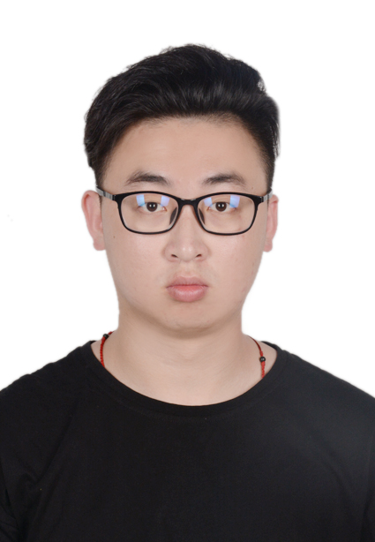
Multi-label Image Recognition with Asymmteric Co-occurrence Dependency Graphs
Presenter’s
Photo
Yuhang Qi
Beijing Jiaotong Univeristy, China
2021 IEEE the 6th International Conference on Big Data Analytics
—— March 5-8, 2021

Slide 2

Outline
Background of the multi-label image recognition
Disadvantages of existing methods
Solution and model
Experiment result
Conclusion

Slide 3
Background of the multi-label image recognition
Definition
  The goal of the multi-label image recognition is to predict a set of categories in an image.
Application
  Pedestrian attribute recognition
  Medical diagnosis recognition
  Retail checkout recognition
  ……

Slide 4
Disadvantages of existing methods
Co-occurrence dependencies
  Some categories in multi-label image recognition depend on each other, and these categories normally co-occur in an image.
Modeling this co-occurrence dependencies is the key to improve the performance of multi-label image recognition.

Slide 5
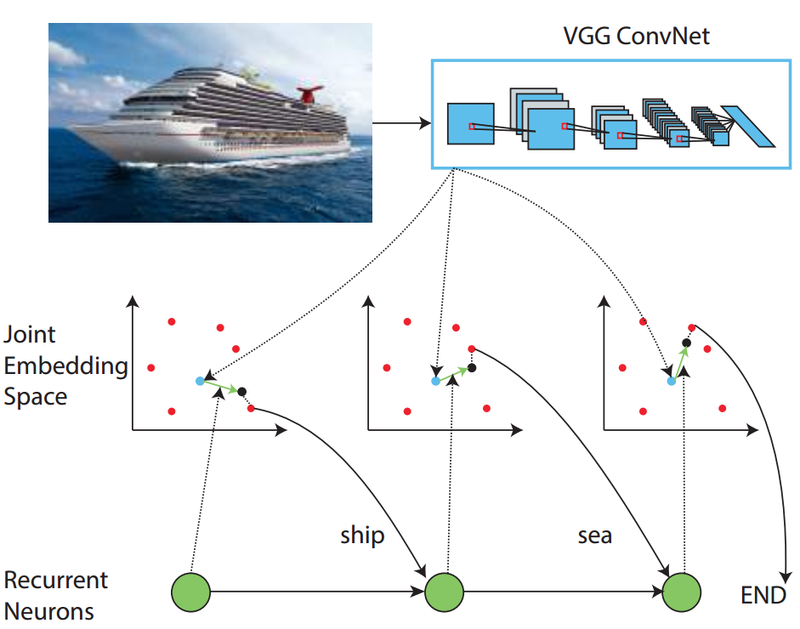
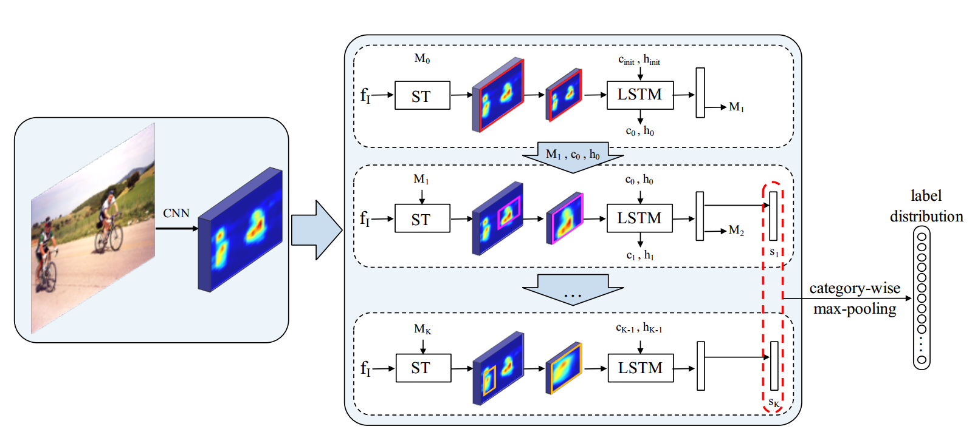
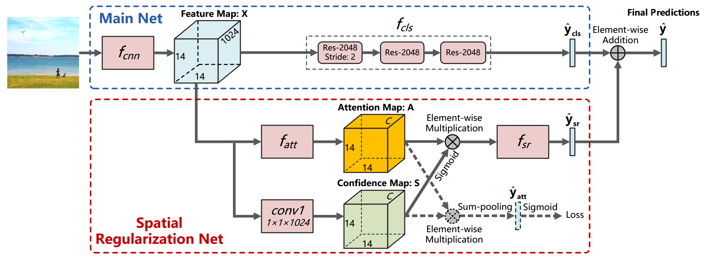
1
3
2
[1] CNN-RNN: A unified framework for multi-label image classification. In CVPR.
[2] Learning spatial regularization with image-level supervisions for multi-label image classification. In CVPR.
[3] Multi-label image recognition by recurrently discovering attentional regions. In ICCV.

Slide 6
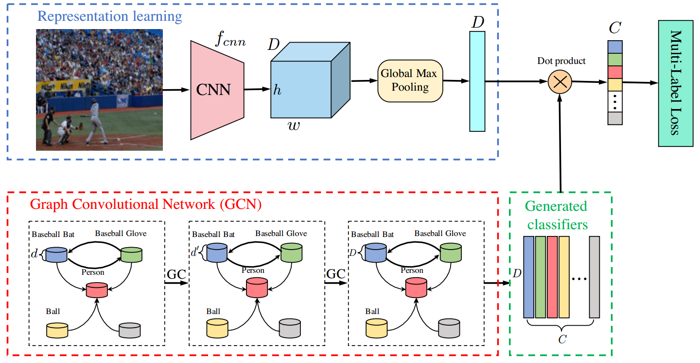
ML-GCN: Multi-Label Image Recognition with Graph Convolutional Networks. In CVPR 2019.

Slide 7
Disadvantages of existing methods
Many directed edges are from the low frequency category to the high frequency category.
Graph convolution network:The forward of GCN can be summarized as the aggregation and transformation of node features.

Slide 8
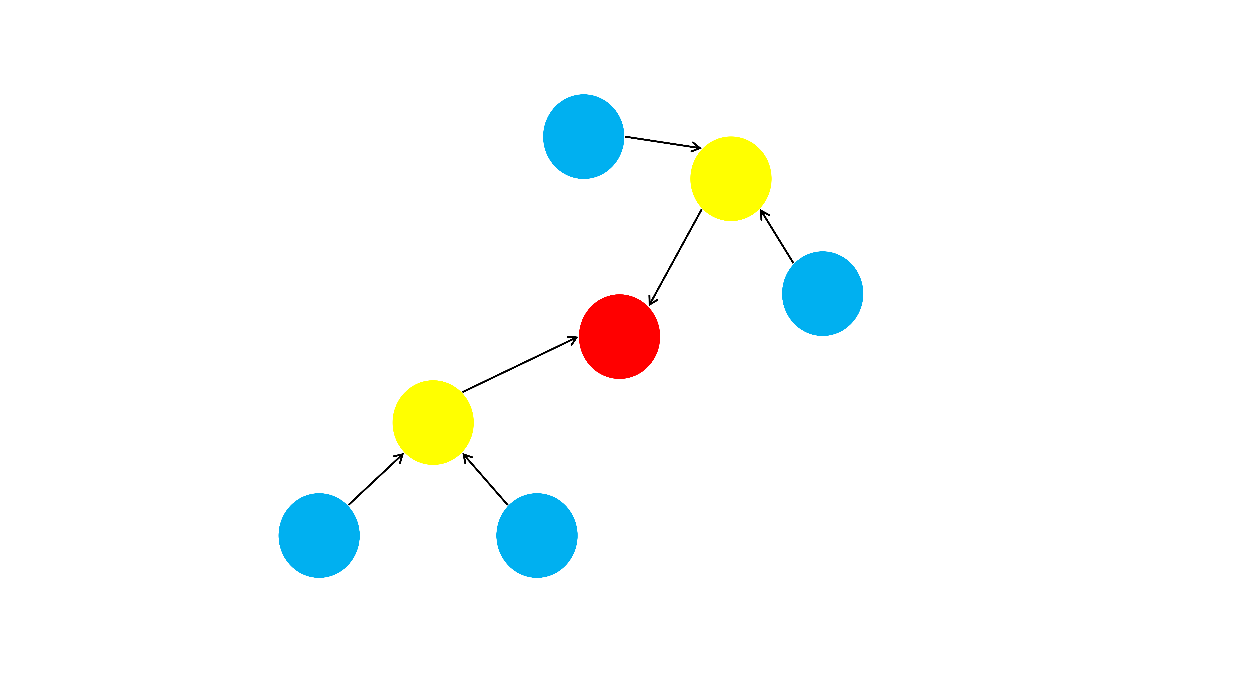

Slide 9
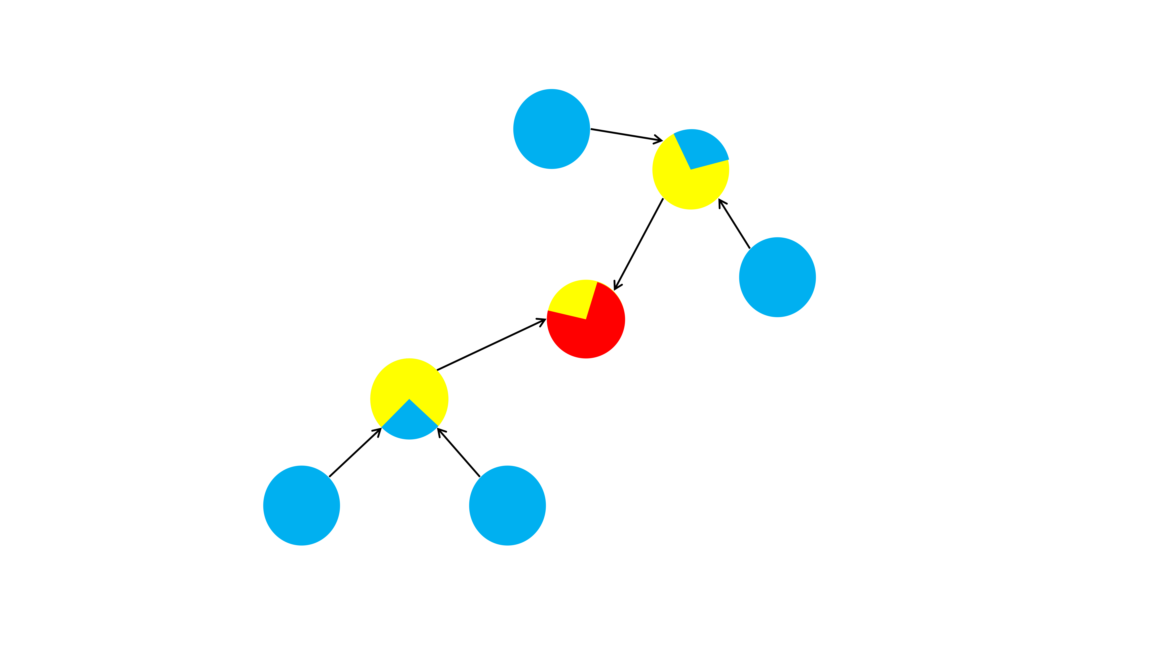

Slide 10
Disadvantages of existing methods
In many co-occurrence dependency graphs built from benchmark datasets, many nodes do not have edges pointing to themselves from other nodes.

Slide 11
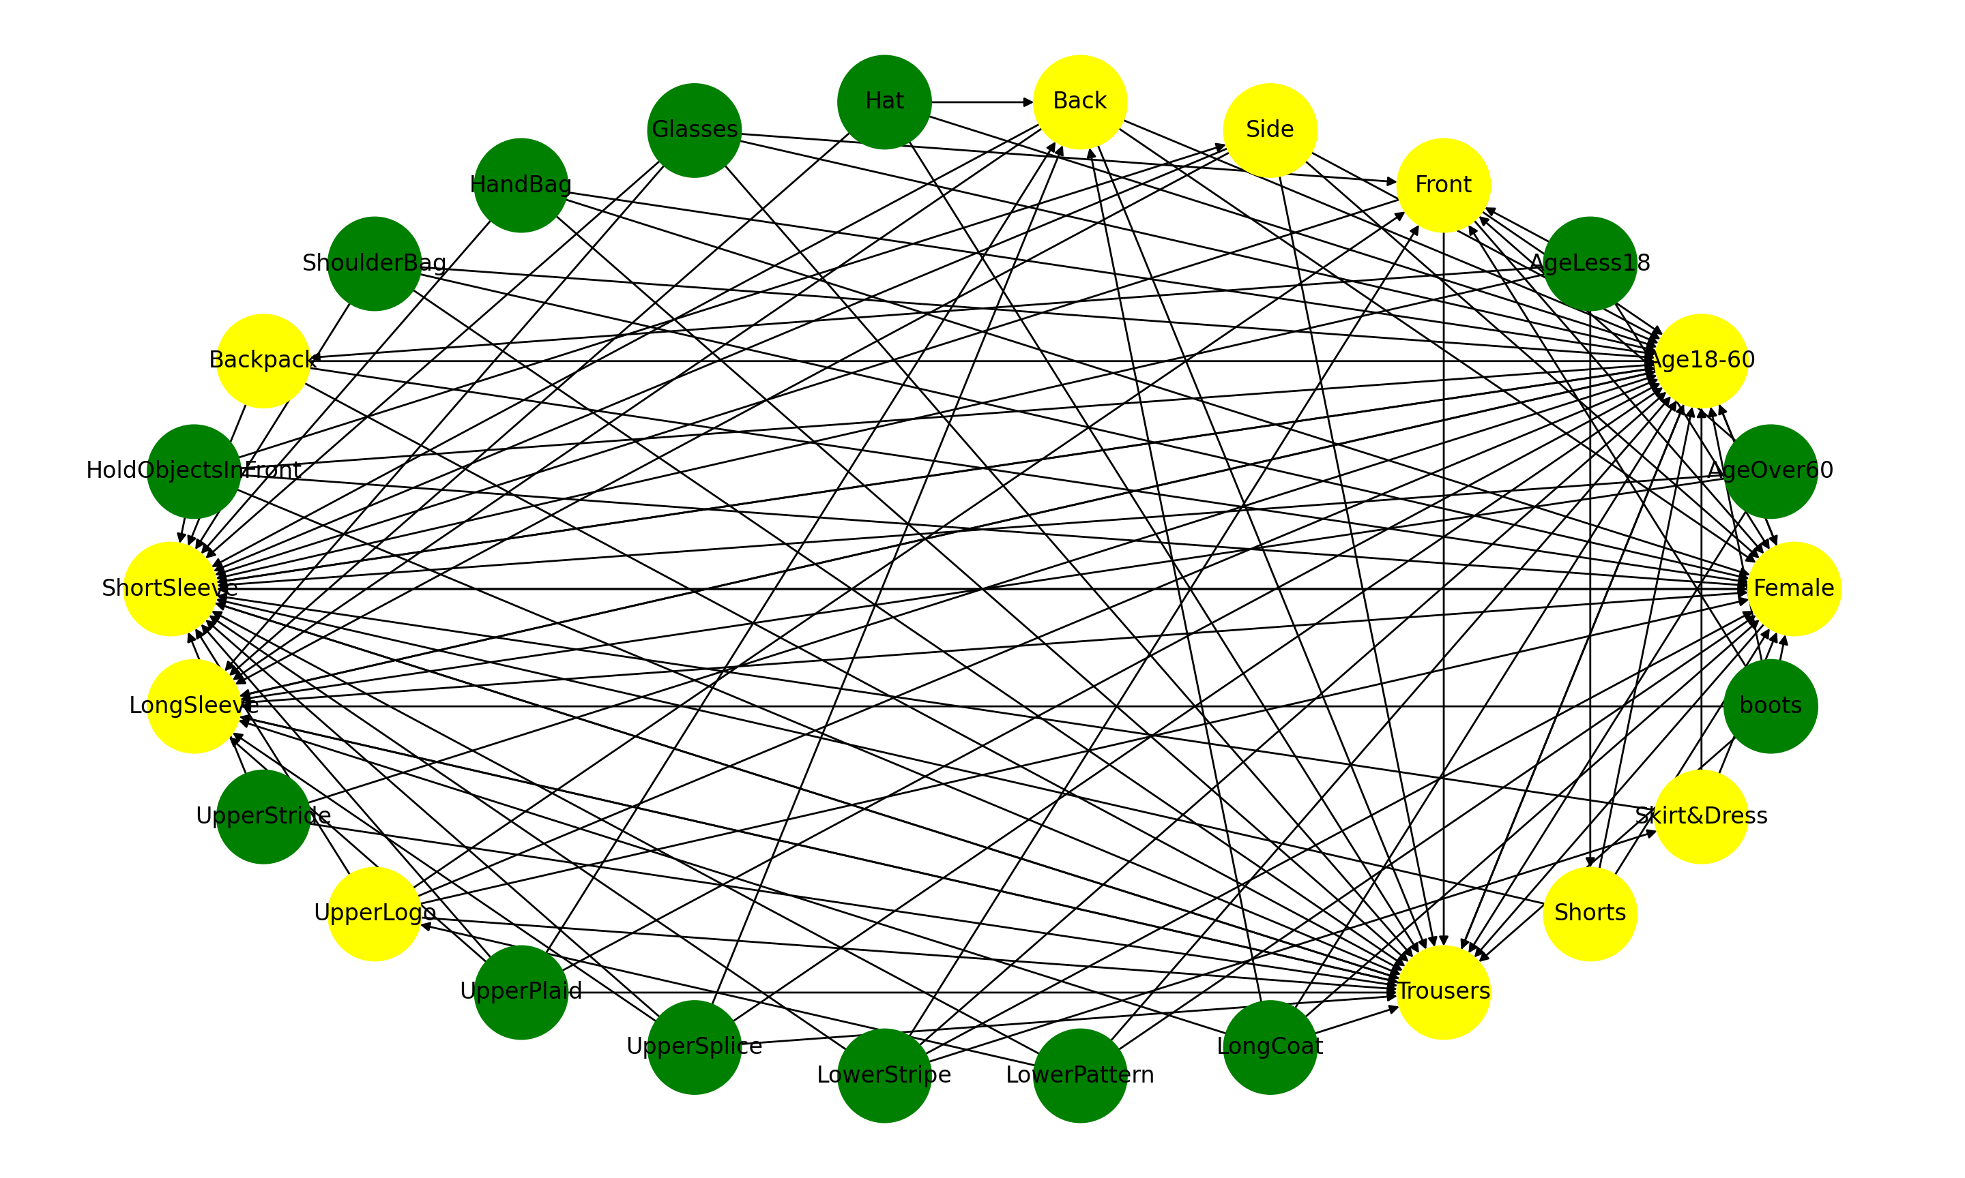

Slide 12
Solution and model
An intuitive method is to reverse the direction of the edge.
Many aggregation directions will be from the category with higher frequency to the category with lower frequency.
After changing the directions of edges, most nodes will have edges pointing to themselves from other nodes.

Slide 13
Solution and model
Using two graphs at the same time, which are constructed by the baseline model and our method of defining the direction of edges, can further solve the second problem and improve the performance.
In order to improve the flexibility of the model, two different conditional probability thresholds are used to create a pair of asymmetric graphs.

Slide 14
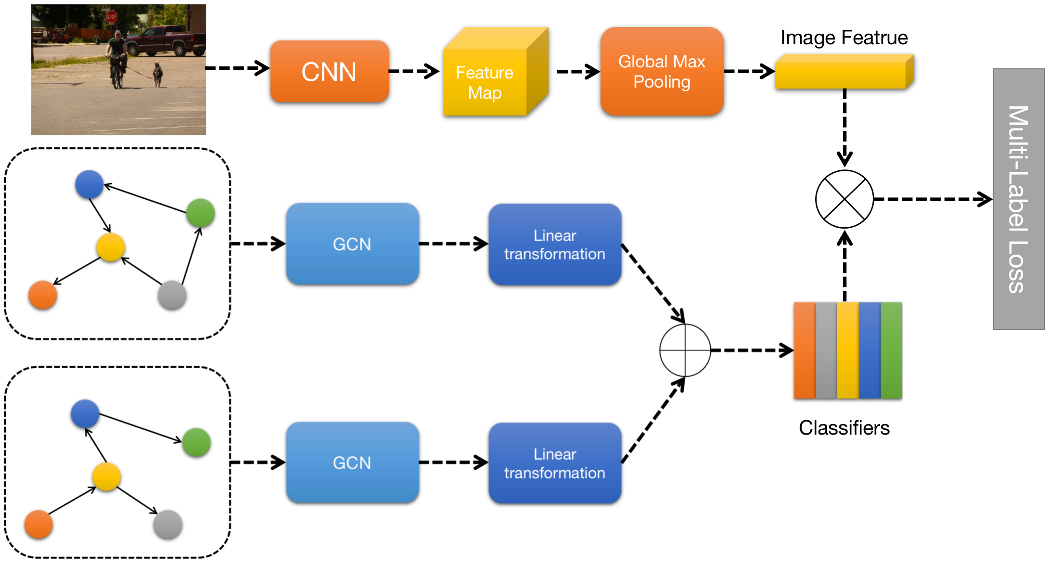
P (green | gray) >= τ1 and P (green | gray) < τ2.

Slide 15
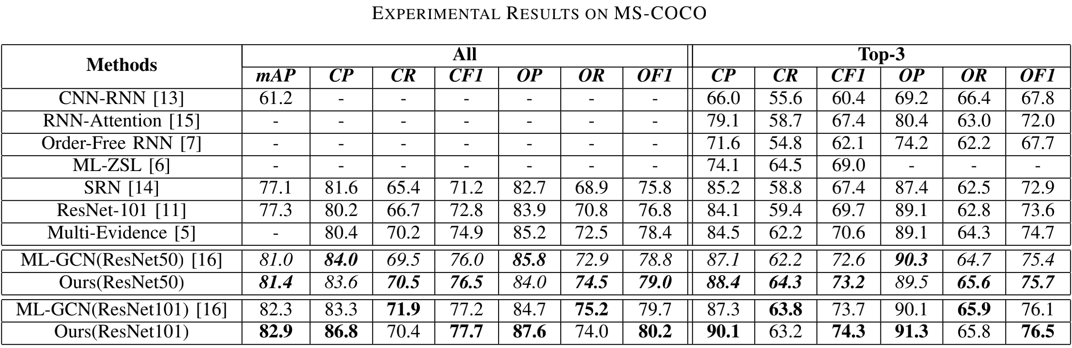
Experiment result

Slide 16
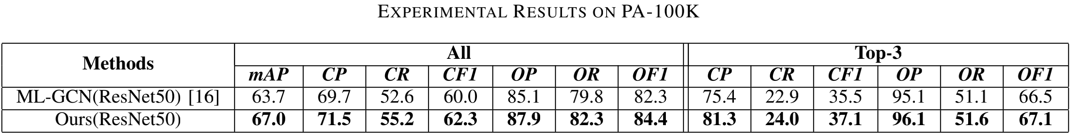
Experiment result

Slide 17
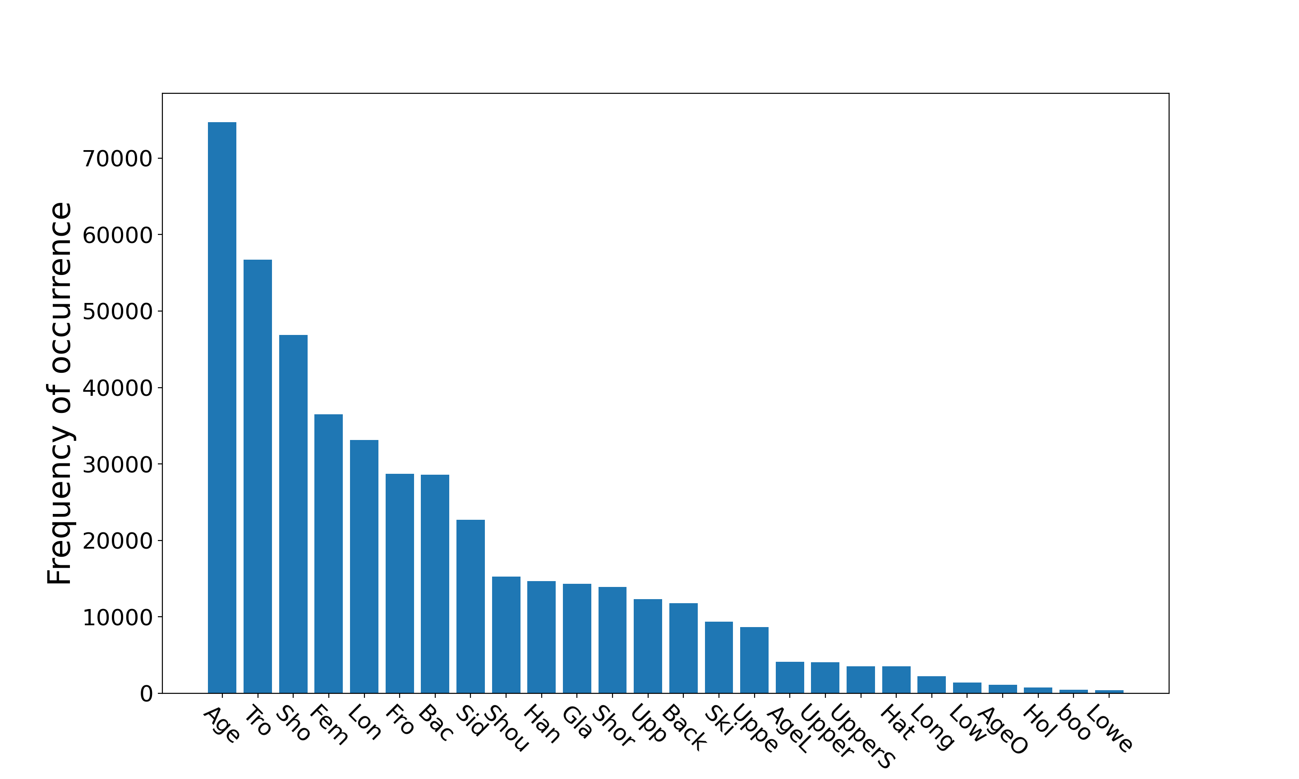
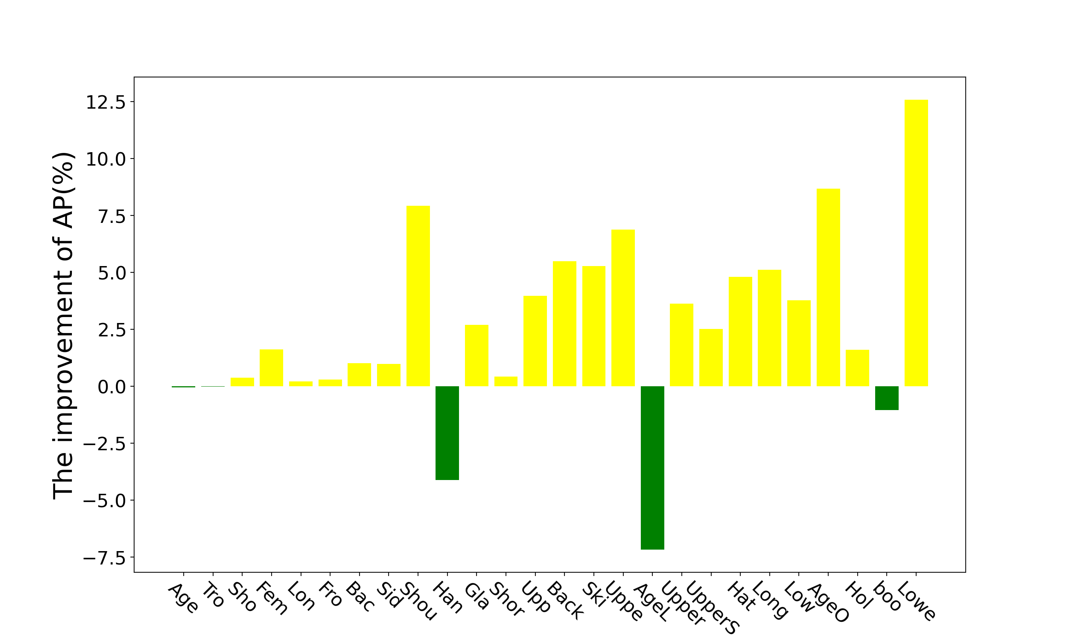
Experiment result

Slide 18
Conclusion
In our paper, we propose that using high-frequency category feature to supplement information for low-frequency category feature can improve the recognition performance of low-frequency categories.
Next, we construct a pair of asymmetric graphs using the two ways, and then uses a unified model to model asymmetric co-occurrence dependency on graph pair.
Finally, we hope that our research can inspire more researches on graph neural network to deal with uneven distribution data.

